Slide 1
How do to a walkthrough
Creating Asthma-Friendly Schools
Notes:
This presentation is adapted by Health Resources in Action from the Environmental Protection Agency (EPA) Tools for Schools Indoor Air Quality Toolkit. It is intended to be approximately 15 minutes long and can be presented to teachers, administrators, parents, and other school staff.
While these slides are a good introduction to the basics, please consult the other resources in the toolkit for more in-depth information.

Slide 2
Finding problems before they find you
School conditions can change and affect the health of students and staff. It is important to identify signs of issues before they become a big problem.
A school walkthrough involves examining and noting observations about the inside and outside of the school building. They are usually brief and provide important information about the health and safety of a school. They also help start a conversation about learning/teaching conditions.
If you don’t look, you don’t know!

Slide 3
Pre-walkthrough
Gather a team of 3 to 5 people to do the walkthrough
Primary team should involve facilitates director, head custodian, and principal
School nurse, teachers, students can play a role
Review inspection and compliance reports from the past
Plan to discuss and verify what is observed
Agree that action will be taken with appropriate timelines
Provide advance notice to staff about the walkthrough
Use a checklist, and bring a flashlight and basic floor plan

Slide 4
Benchmarks for a healthy building
Dry
Clean
Comfortable
Pollutants controlled
Adequate ventilation

Slide 5
Use your senses
You do not need to be an expert to conduct a walkthrough
You will mainly be using your 4 senses: sight, smell, touch, hearing
If something is out of your scope, consult a specialist

Slide 6
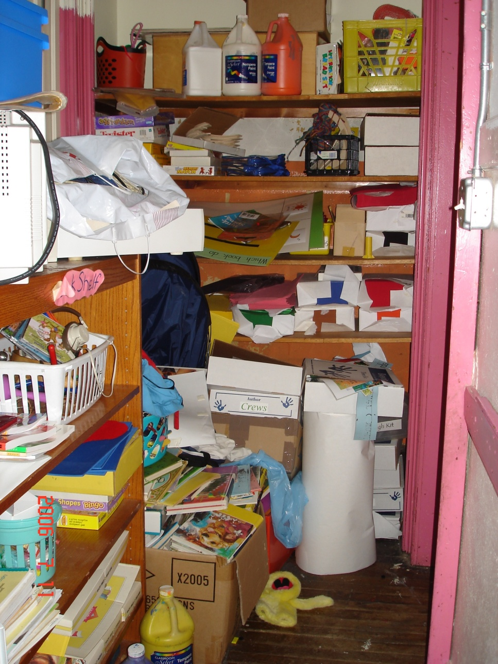
Use your senses: Observe
Scan the rooms and halls for general cleanliness and signs of pests
Look inside and outside, top and bottom
Are there sources of mold? Are there water stains?
Are the vents clean?
Are there any books or other objects blocking the vents?
Is there a lot of clutter?

Slide 7
Use your senses: Smell
Are there unusual odors? Can you find the source?
Is there adequate ventilation?
Do you smell strong chemical fumes?

Slide 8
Use your senses: Feel
Are there uncomfortable air temperature changes?
Do you feel very dry or humid conditions?
Are the walls/ceilings damp?

Slide 9
Use your senses: Listen
Are there unusual equipment noises?
Are there noisy vents?

Slide 10
Post-walkthrough
Some problems may be resolved immediately, while some may require more time and response from the school department. The key is to be patient.
Create an Action Plan with team
Agree on priority issues
Outline who will follow up on each item and provide a timeline
Use the data found to start a conversation/make a case about conditions in the school

